Slide 1
Section 4.1
Basic Graphs

Slide 2
Period of a Function

Slide 3
Period of a Function
In addition, such a function is called a periodic function

Slide 4
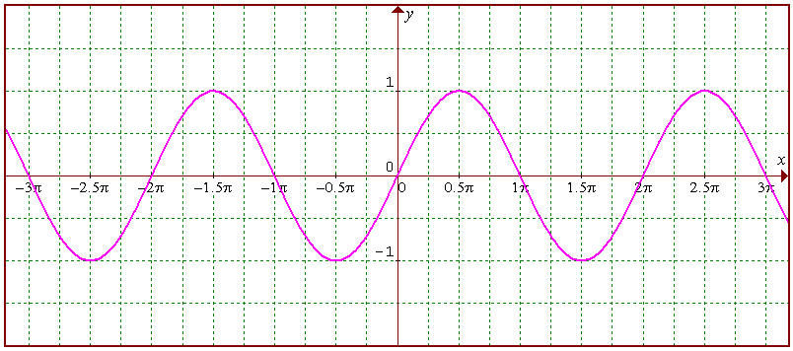
Period of a Function

Slide 5
Period of a Function

Slide 6
Period of a Function

Slide 7
Period of a Function

Slide 8
Amplitude of a Periodic Function

Slide 9
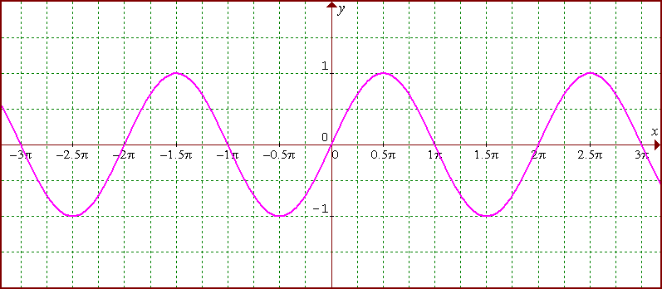
Amplitude of a Periodic Function

Slide 10
Amplitude of a Periodic Function
M
m

Slide 11
Graphs of Trigonometric Functions

