Slide 1
Section 3.5
Velocities

Slide 2
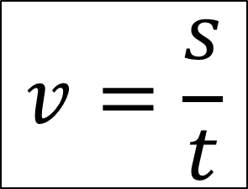
Linear Velocity
$$v=\frac{s}{t}$$
$$S=linear distance$$
$$t=time$$

Slide 3
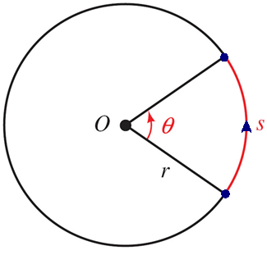
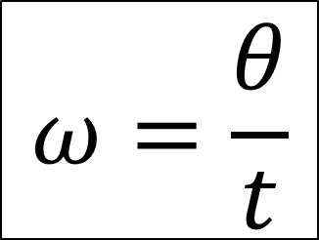
Angular Velocity
$$ω=\frac{θ}{t}$$

Slide 4
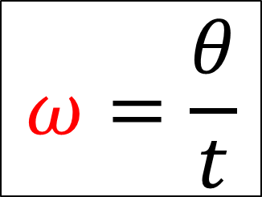
Angular Velocity
Greek Letter Omega
(lowercase)
$$ω=\frac{θ}{t}$$

Slide 5
Angular Velocity
#1: A CD player turns a CD at about 13680˚ in 5 seconds. What is the angular speed of the cd in radians per second?

Slide 6
Linear Velocity and Angular Velocity
#2: Example 3 page 157
A bicycle wheel with a radius of 13 inches turns with an angular velocity of 3 radians per second. Find the distance (in feet) traveled by a point on the bicycle tire in 1 minute.

Slide 7
Linear Velocity and Angular Velocity
Derivation

Slide 8
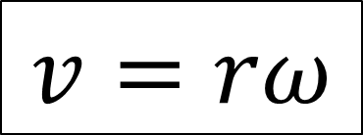
Linear Velocity and Angular Velocity
$$v=rω$$
$$v=\frac{s}{t}$$
$$ω=\frac{θ}{t}$$

Slide 9
Linear Velocity and Angular Velocity
#3: A record is spinning at the rate of 25 rpm. If a ladybug is sitting 10 cm from the center of the record:

Slide 10
Linear Velocity and Angular Velocity
#3: A record is spinning at the rate of 25 rpm. If a ladybug is sitting 10 cm from the center of the record:
a) What is the angular velocity of the ladybug? (radians/sec)

Slide 11
Linear Velocity and Angular Velocity
#3: A record is spinning at the rate of 25 rpm. If a ladybug is sitting 10 cm from the center of the record:
a) What is the angular velocity of the ladybug? (radians/sec)
b) What is the speed of the ladybug? (in cm/sec)

Slide 12
Linear Velocity and Angular Velocity
#3: A record is spinning at the rate of 25 rpm. If a ladybug is sitting 10 cm from the center of the record:
a) What is the angular velocity of the ladybug? (radians/sec)
b) What is the speed of the ladybug? (in cm/sec)
c) After 20 seconds, how far has the ladybug traveled? (cm)

Slide 13
Linear Velocity and Angular Velocity
#3: A record is spinning at the rate of 25 rpm. If a ladybug is sitting 10 cm from the center of the record:
a) What is the angular velocity of the ladybug? (radians/sec)
b) What is the speed of the ladybug? (in cm/sec)
c) After 20 seconds, how far has the ladybug traveled? (cm)
d) After 20 seconds, what angle has the ladybug turned through? (radians)

Slide 14
Linear Velocity and Angular Velocity
#4: Page 161 Problem #61

