Slide 1
Section 3.4
Arc length &
area of a sector

Slide 2
Arc Length

Slide 3
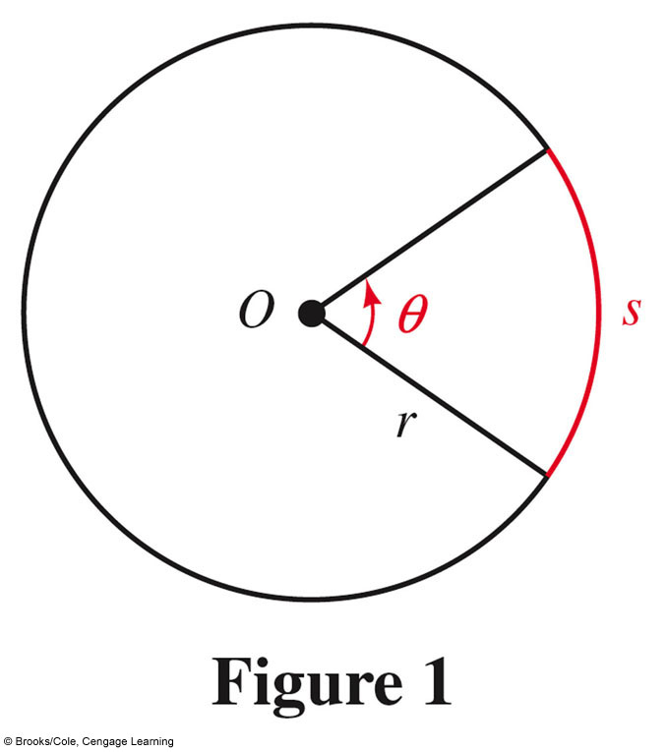
Arc Length

Slide 4
Arc Length
$$Arc Length=radius × Angle Measure (Radians)$$

Slide 5

Arc Length
To use this formula,
$θ$must be in radians
$$Arc Length=radius × Angle Measure (Radians)$$
$$S=rθ$$

Slide 6
Arc Length
#1: Find the radius of an 15 foot arc of a circle that subtends and angle of 15˚
To use this formula,
$θ$must be in radians
$$Arc Length=radius × Angle Measure (Radians)$$
$$S=rθ$$

Slide 7
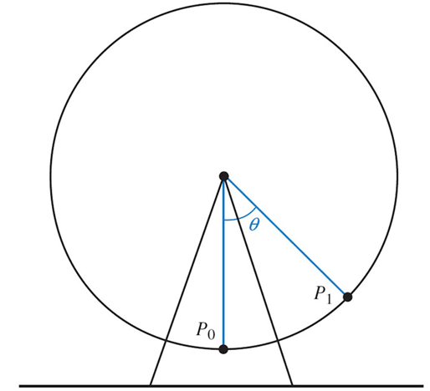
Arc Length
#2: The diameter of a Ferris Wheel is 200 ft. and θ is the central angle formed as a rider travels from her initial position of P₀ to P₁. Find the distance she travels if θ = 30˚.

Slide 8
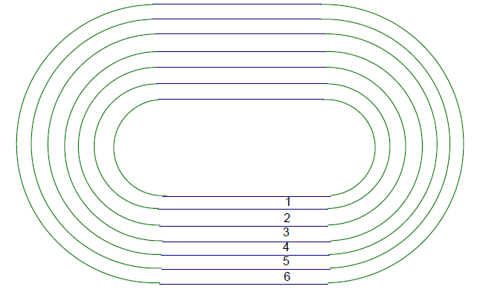
Arc Length
#3: One way to construct a 400 meter race trace is to make each straight-away 100 meters long and the semicircles for the inner track 100 meters each. In a 400 meter race, how much of a “head start” should the runner is the 6th lane get over the runner in the 1st lane.

Slide 9
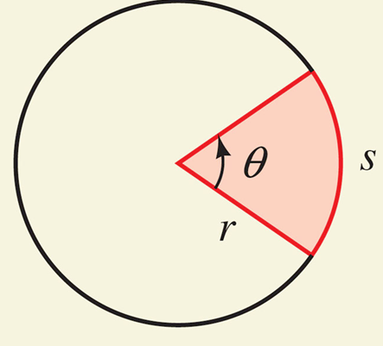
Area of a Sector
Derivation

Slide 10
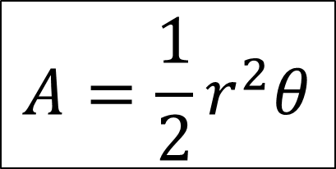
Area of a Sector
To use this formula,
$θ$must be in radians
$$A=\frac{1}{2}r^{2}θ$$

Slide 11
Area of a Sector
#4: A lawn sprinkler shoots out water 20 feet and rotates 135˚. Find the area of lawn that is watered by the sprinkler.

Slide 12
Area of a Sector
#5: Find the degree measure of an angle that is subtended by an arc of a sector that has an area of 30$π$ square feet if radius of the arc is 10 feet.
$$A=\frac{1}{2}r^{2}θ$$

Slide 13
Area of a Sector
#6: Find the arc length of a sector of a circle that has a central angle of 20˚ and an area of 450$π$ square meters.

