Slide 1
Section 2.5
Vectors

Slide 2
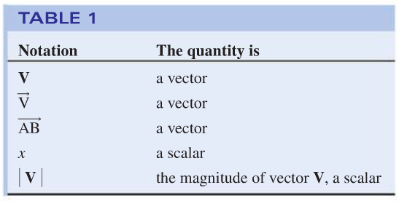
Vectors

Slide 3
Vectors
Vectors are said to be equal if they have the
same magnitude and direction

Slide 4
Vectors
Addition and Subtraction of Vectors

Slide 5
Vectors
Examples

Slide 6
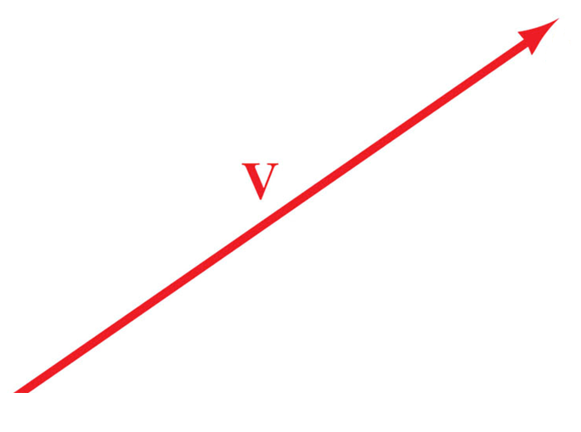
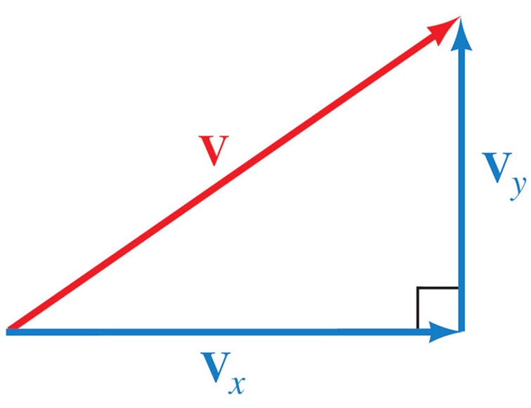
Horizontal and Vertical Components

Slide 7
Horizontal and Vertical Components

Slide 8
Horizontal and Vertical Components
Finding horizontal and vertical components on the calculator

Slide 9
Horizontal and Vertical Components

Slide 10
Horizontal and Vertical Components
Finding horizontal and vertical components on the calculator

Slide 11
Horizontal and Vertical Components
Finding horizontal and vertical components on the calculator
P→Rx (magnitude, angle in degrees)
P→Ry (magnitude, angle in degrees)

Slide 12
Horizontal and Vertical Components
Examples

